Slide 1
Unit VI
WEB APPLICATION DEPLOYMENT

Slide 2
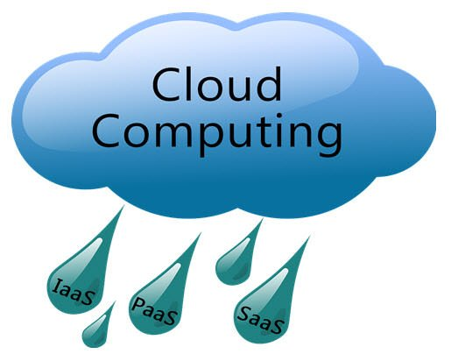
What is Cloud Computing?
Cloud Computing is defined as storing and accessing of
data and computing services over the internet.
The main purpose of cloud computing is to give access to
data centers to many users. Users can also access data from a remote server.
A cloud can be private or public.

Slide 3
Why Cloud Computing?
Cloud computing decreases the hardware and software demand from the user’s side.
Benefits of Cloud Computing:
Lower IT infrastructure and computer costs for users
Improved performance
Fewer Maintenance issues
Instant software updates
Improved compatibility between Operating systems
Backup and recovery
Performance and Scalability
Increased storage capacity
Increase data safety

Slide 4
Cloud computing service providers
AWS GCP Microsoft Azure Apple Citrix IBM Salesforce | Alibaba Oracle VMware SAP Joyent Rackspace

Slide 5
Cloud Services
Email
Storage, backup, and data retrieval
Creating and testing apps
Analysing data
Audio and video streaming
Delivering software on demand

Slide 6
AWS Cloud
Amazon Web Services (AWS) is the world’s most comprehensive and broadly adopted cloud platform, offering over 200 fully featured services from data centers globally.
AWS is provider that enables on-demand services like compute, storage, networking, security, databases, etc. which can be accessed through the internet across the globe and the user is not required to manage or monitor these resources.
Amazon Web Services is a global leader in terms of Public Cloud market share and provides cloud solutions in 245 different countries across the globe.

Slide 7
AWS is the leading cloud platform
Most functionality
Largest community of customers and partners
Most secure
Fastest pace of innovation
Most proven operational expertise
Global network of AWS Regions

Slide 8
Benefits of Amazon Web Services
AWS Pricing
Zero Commitment
Scalability and Procurement
Security
Flexible
PaaS Offerings
Adaptable
API

Slide 9
AWS Services
AWS computer services
Storage
Databases services
Security services
Analytics
Developer tools
Deployment and management
Mobile services
Internet of Things
Migration

Slide 10
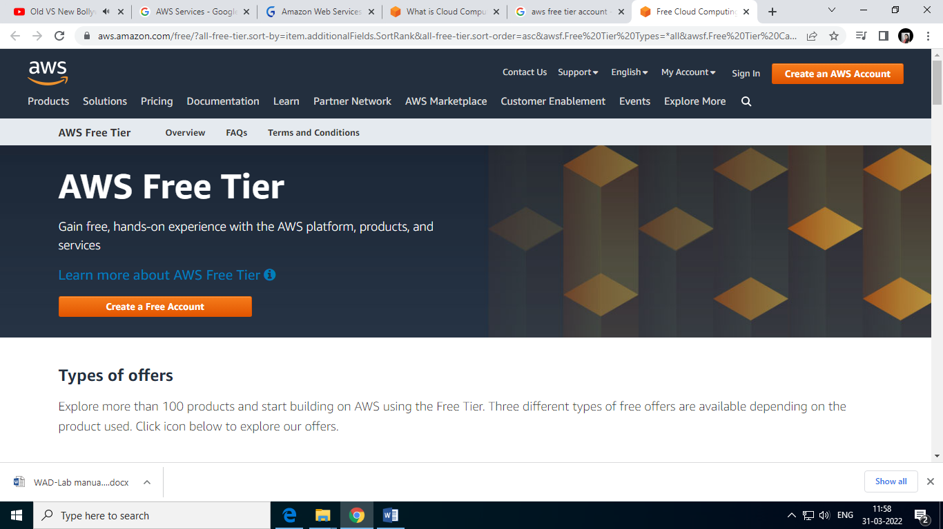
Create AWS Free Tier Account
Step 1 – Visiting the Signup Page
Go to https://aws.amazon.com

Slide 11
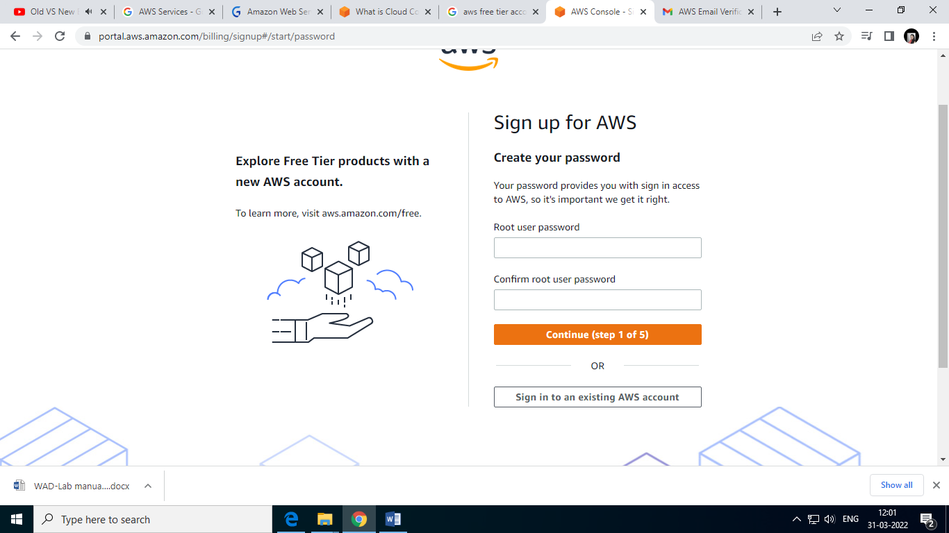
Step 2 – Entering User Details

Slide 12
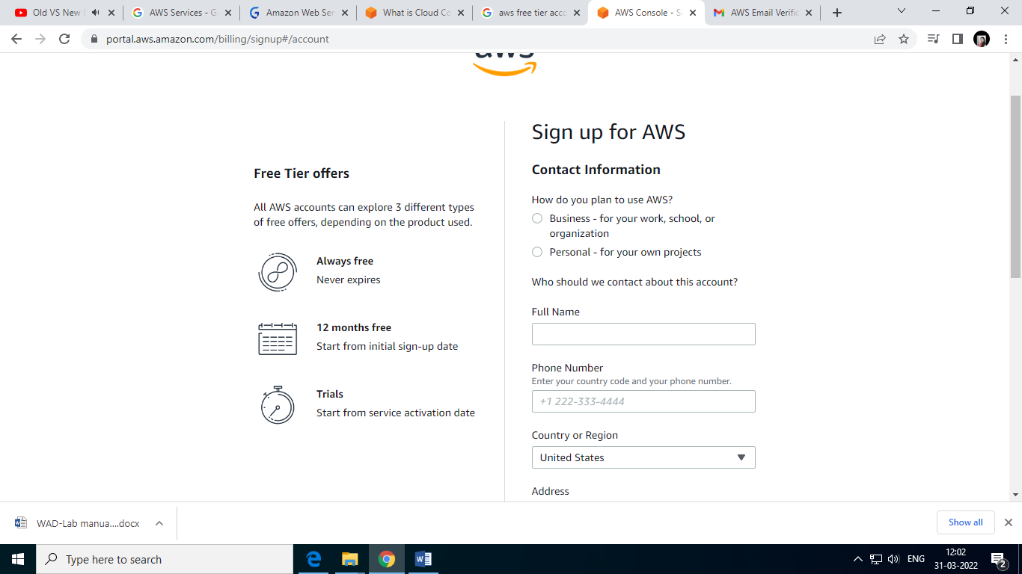

Slide 13
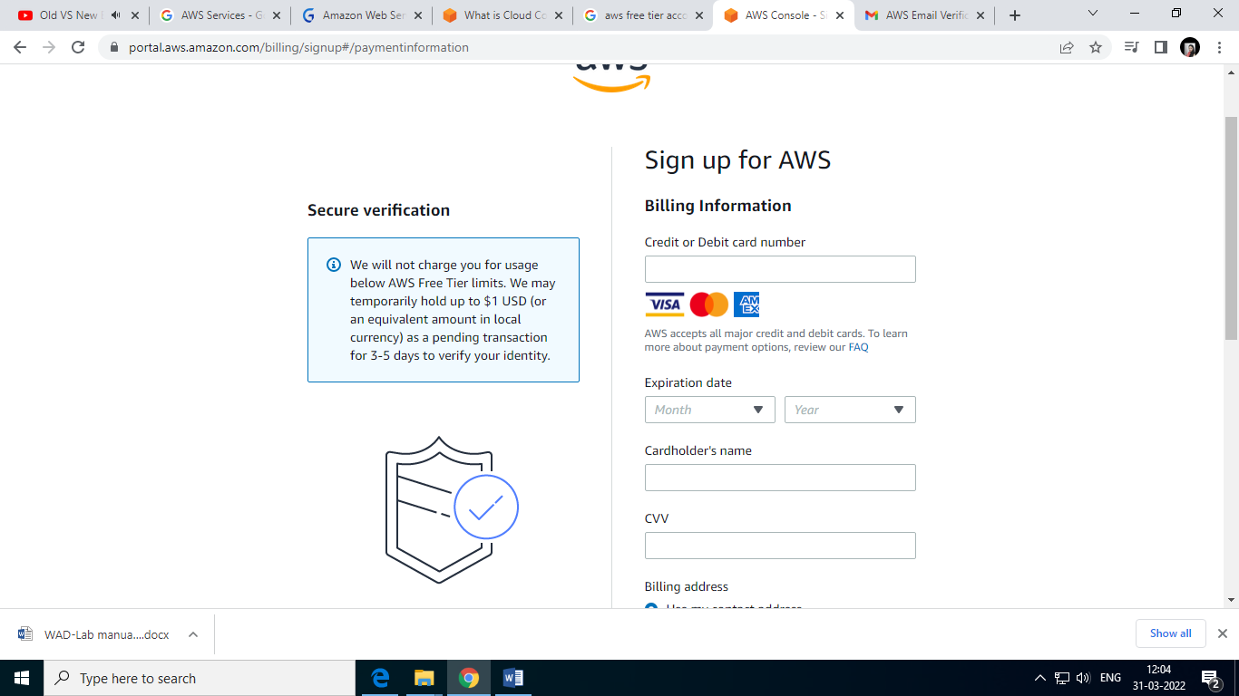
Step 3 – Filling up the Credit Card details

Slide 14
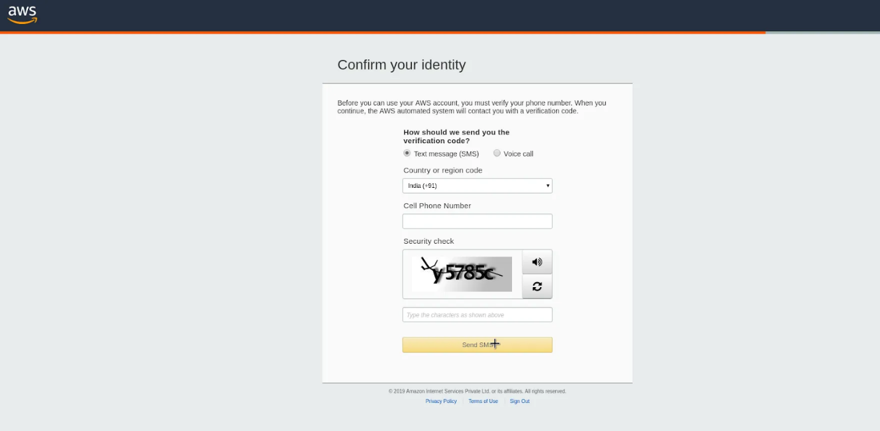
Step 4 – Identity Confirmation

Slide 15
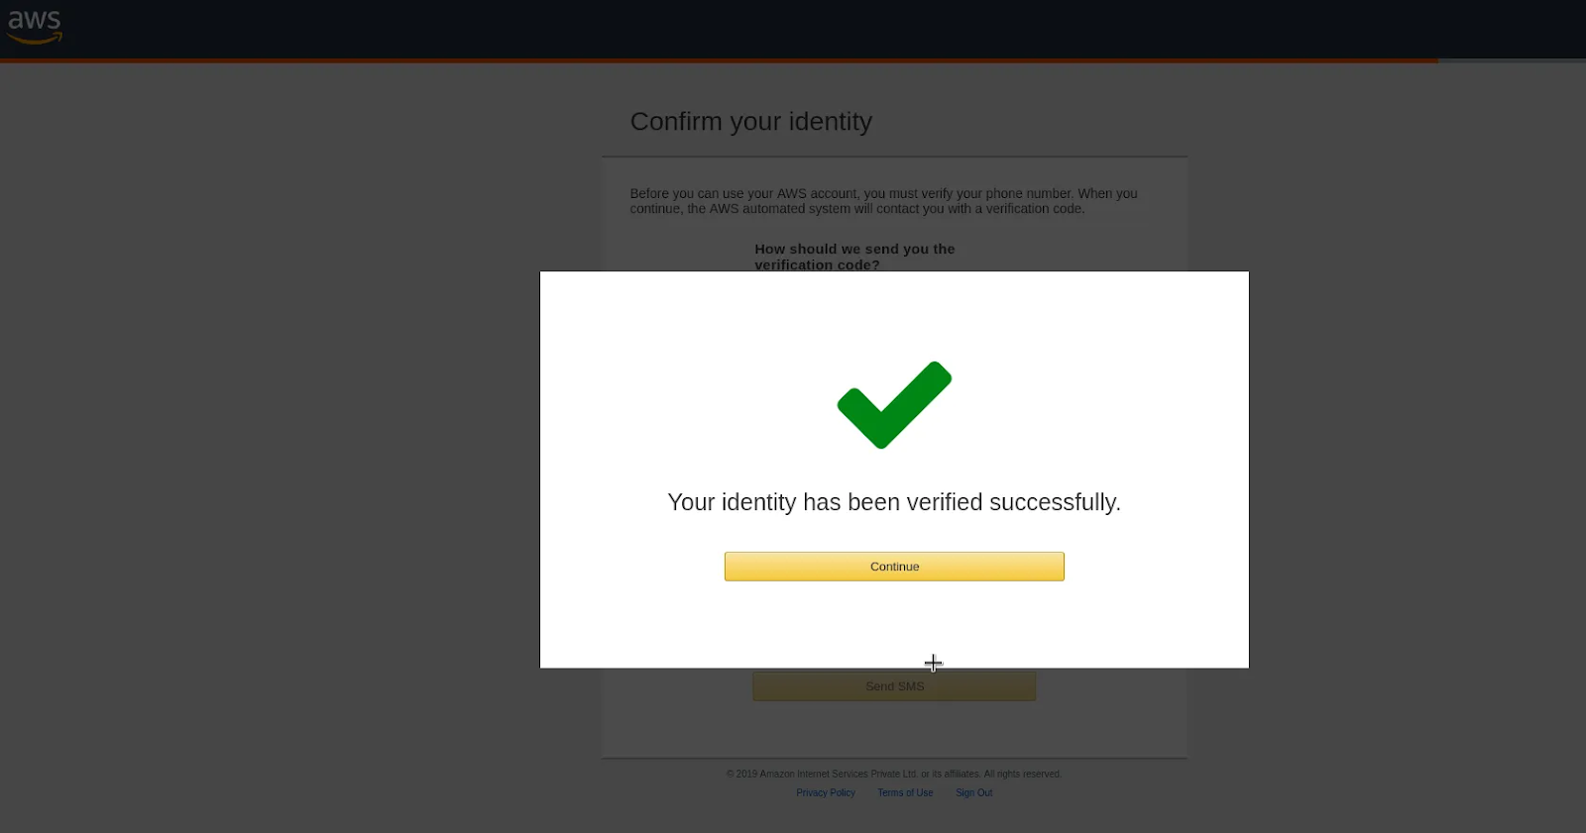

Slide 16
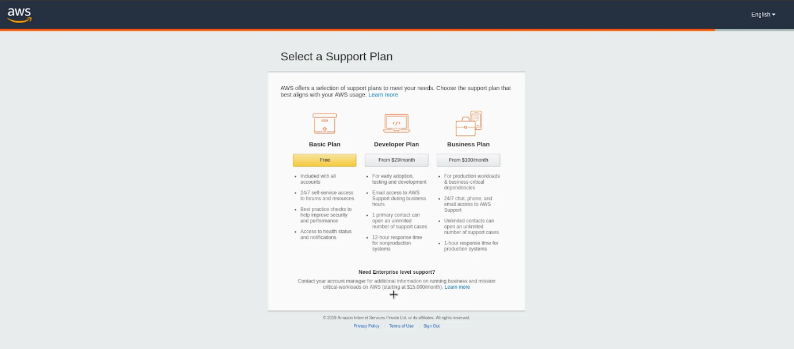
Step 5 – Selecting a Support Plan

Slide 17
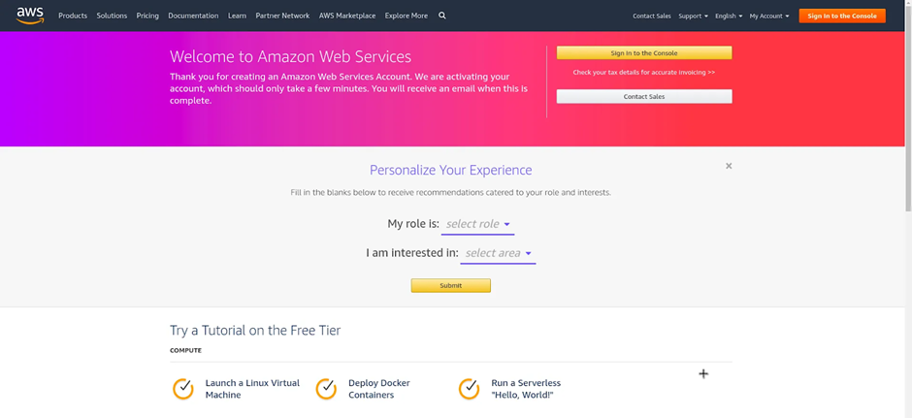

Slide 18
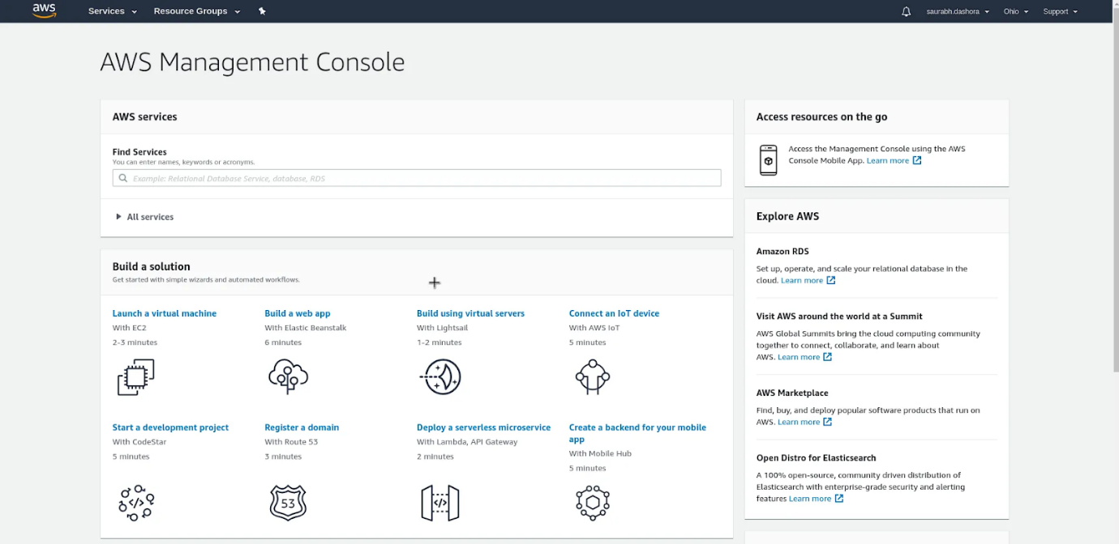
AWS Management Console

Slide 19
AWS Elastic Compute
Amazon EC2 (Elastic Compute Cloud), one of Amazon Web Services’ most well-known services, offers businesses the ability to run applications on the public cloud.
An EC2 is a virtual machine that represents a physical server for you to deploy your applications.
EC2 instances have a unique feature that is fundamental to cloud computing called Auto-Scaling Groups.
IN OTHER WORDS
A custom rubber band that can stretch for building applications.

Slide 20
Features of AWS EC2
Global Infrastructure
Multiple Locations
Choice of operating systems and software
Cost and Capacity Optimization
Pay for What You Use
Scale Seamlessly with Amazon EC2 Auto Scaling
Optimize Compute Performance and Cost with Amazon EC2 Fleet
Optimized CPU Configurations
Pause and Resume Your Instances
Storage
Optimal storage for every workload
Networking
Operating Systems and Software

Slide 21
AWS EC2 Benefits
One of the main benefits of AWS EC2 is its elastic load balancing. This automatically distributes incoming application traffic across several instances, while also identifying unhealthy instances and rerouting traffic to the healthy versions until restored.
Additional benefits include:
EC2 reduces the time to boot new servers
Scaling capacity based on changes to computing requirements
Complete control of servers
Flexibility with operating systems
Built-in security

Slide 22
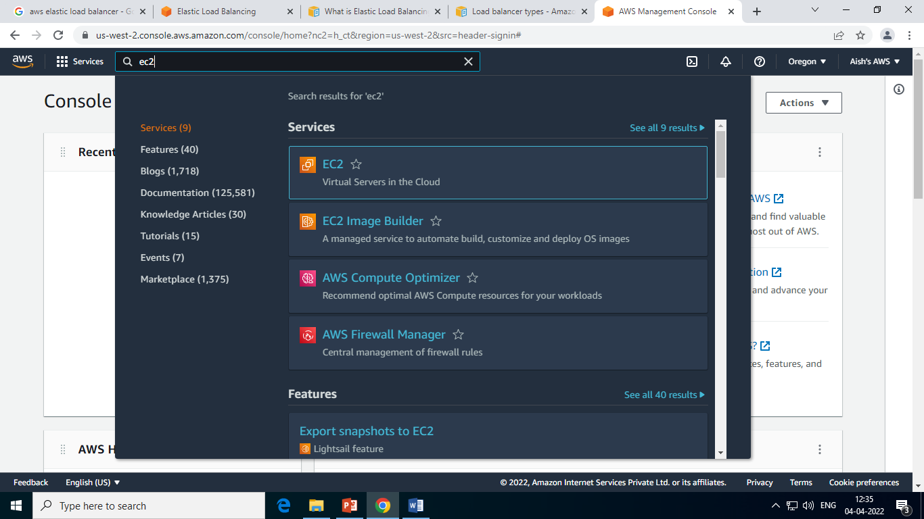
Create EC2 Instance

Slide 23
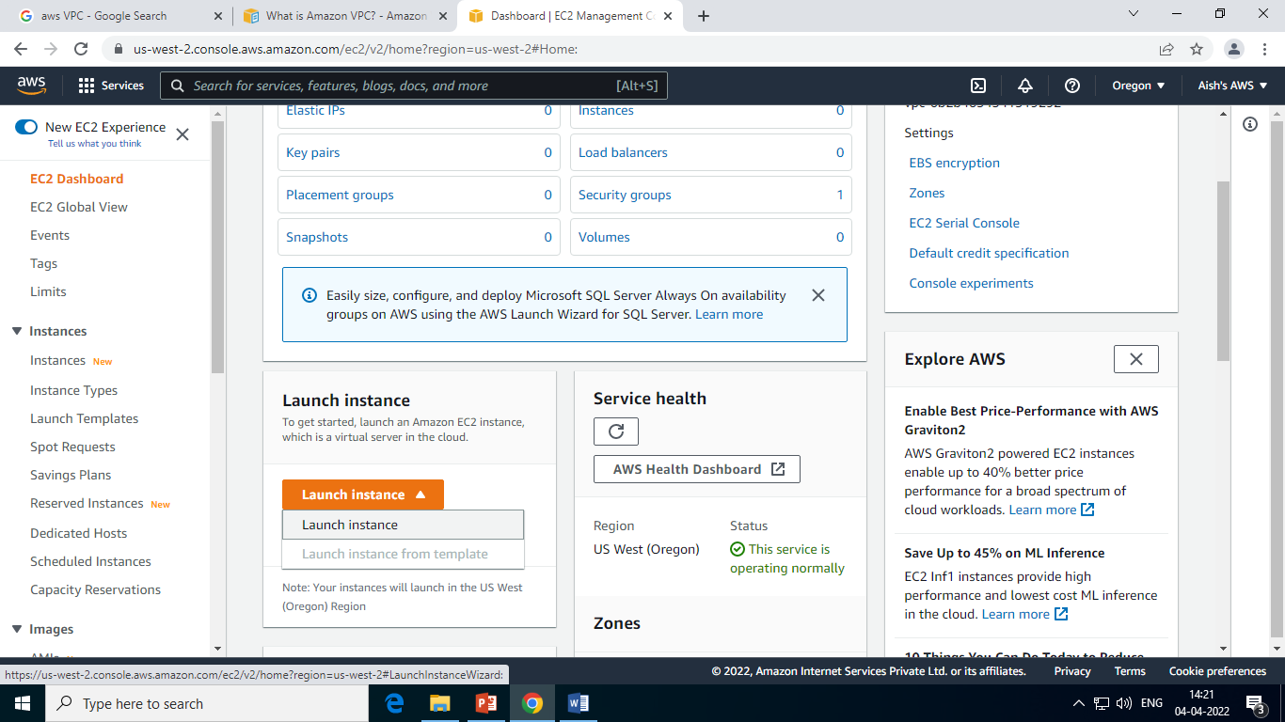
Create EC2 Instance

Slide 24
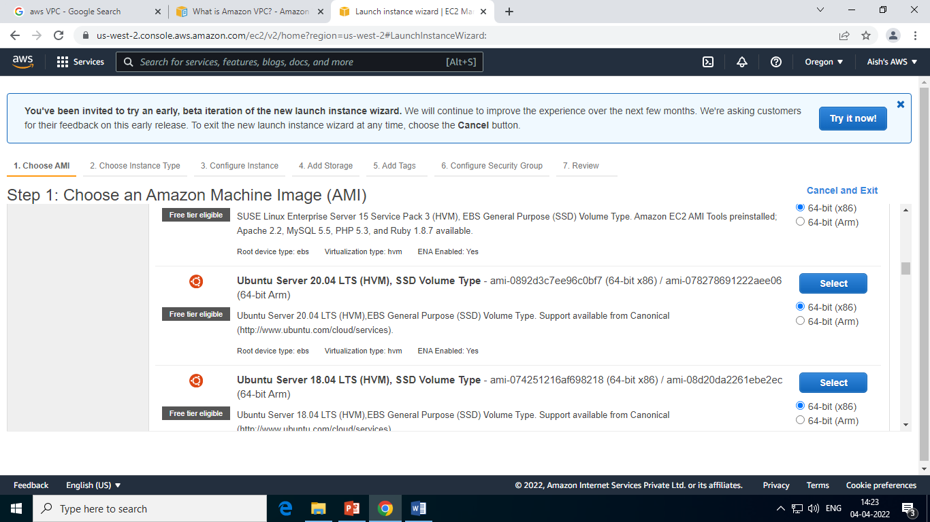
Create EC2 Instance

Slide 25
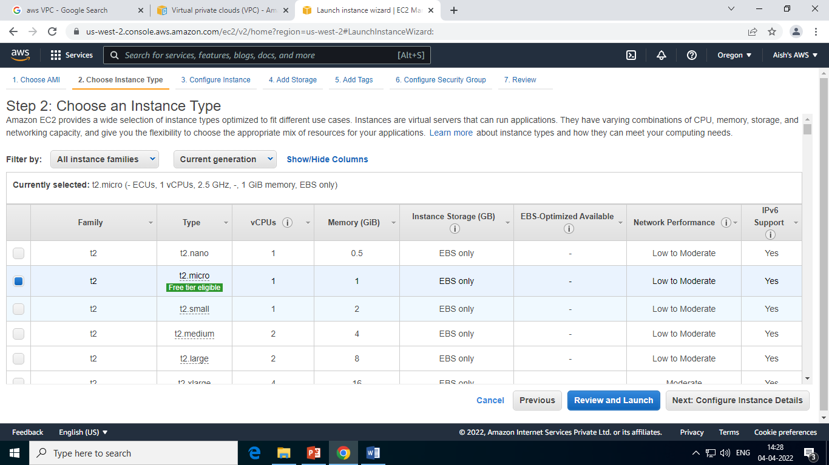
Create EC2 Instance

Slide 26
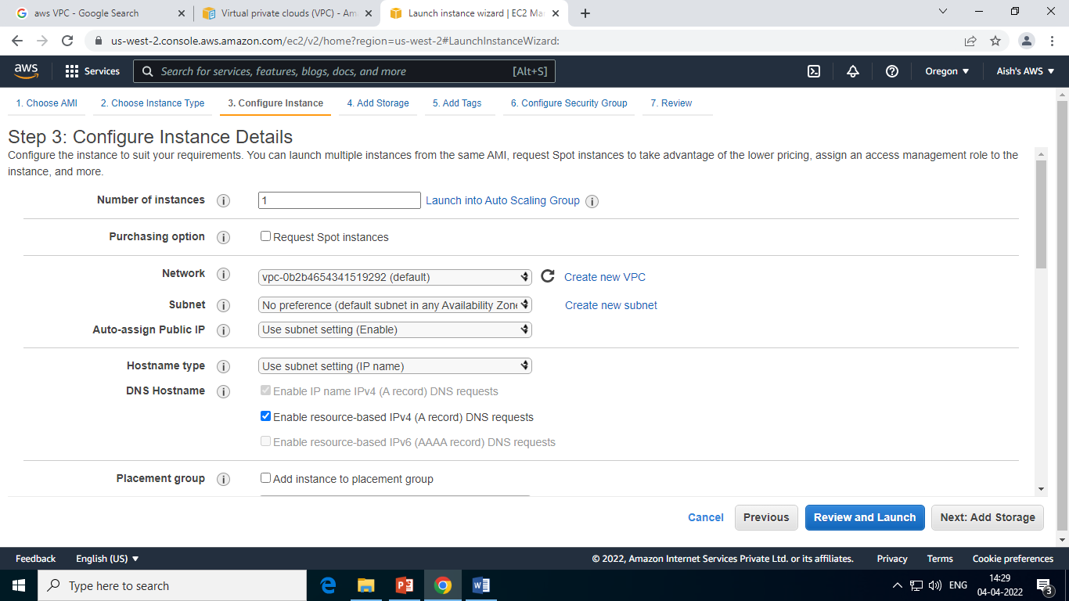
Create EC2 Instance

Slide 27
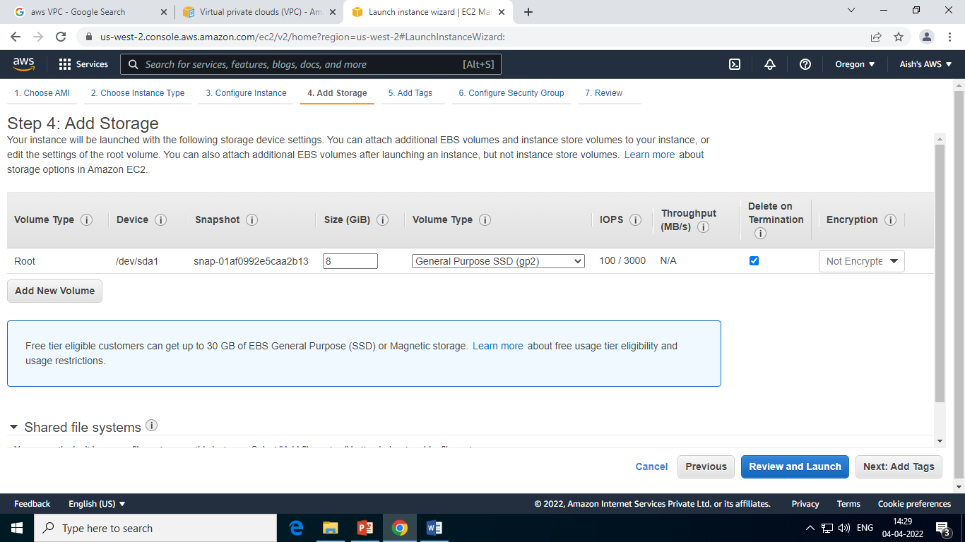
Create EC2 Instance

Slide 28
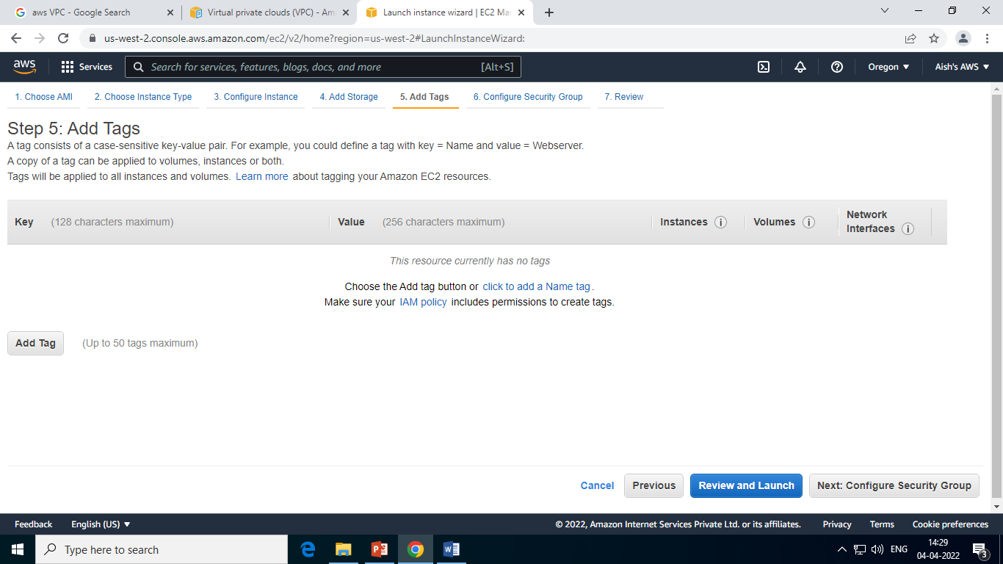
Create EC2 Instance

Slide 29
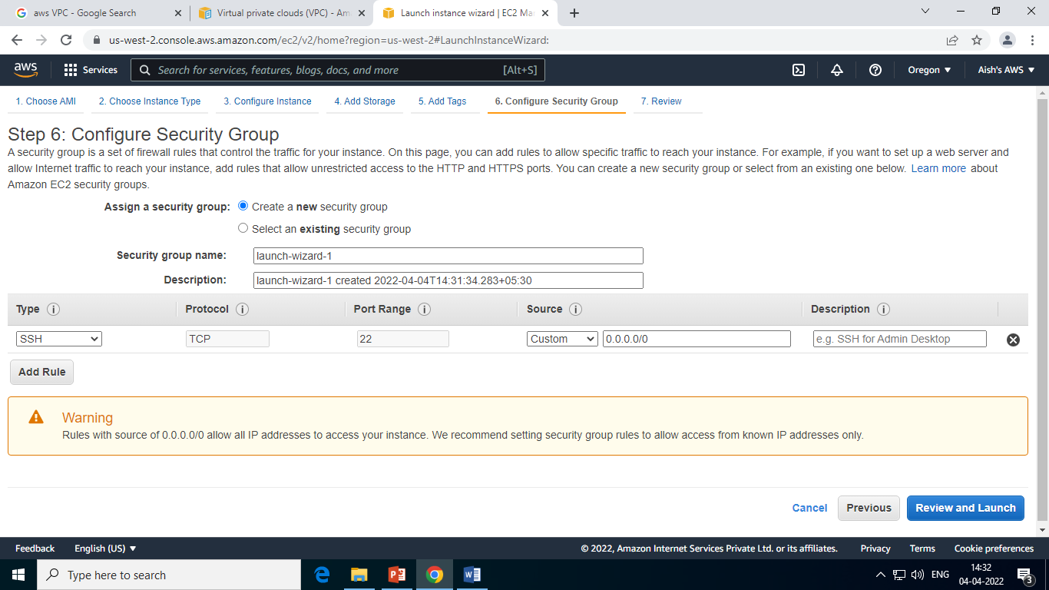
Create EC2 Instance

Slide 30
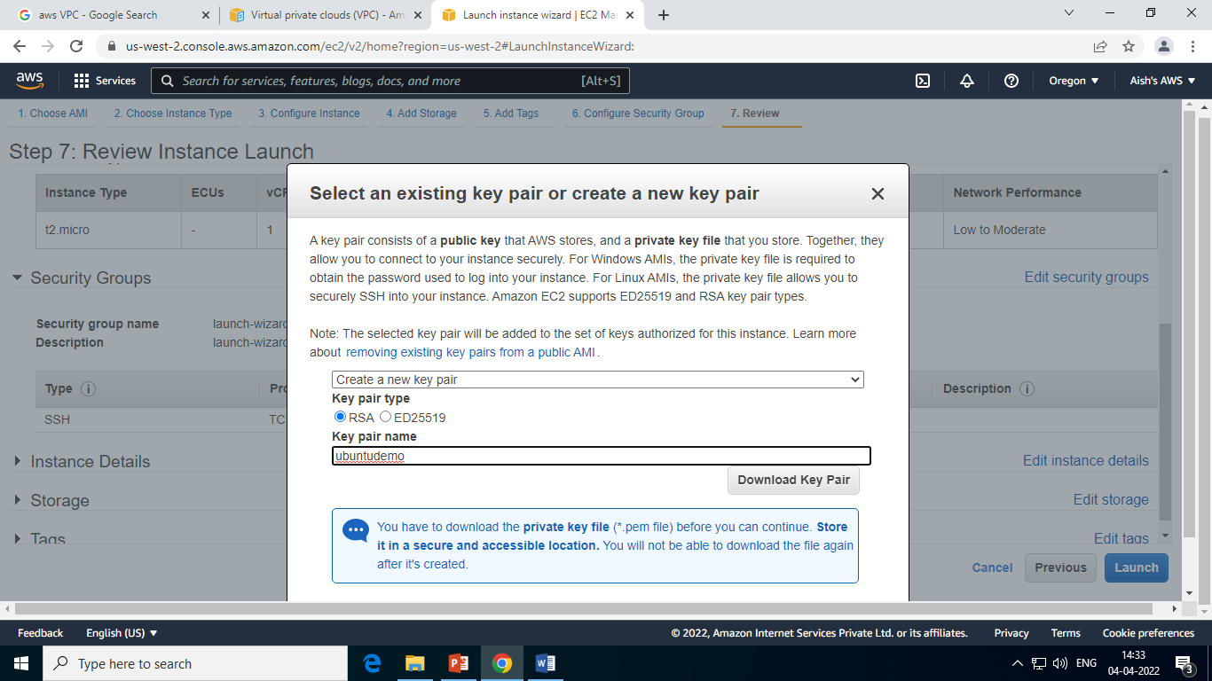
Create EC2 Instance

Slide 31
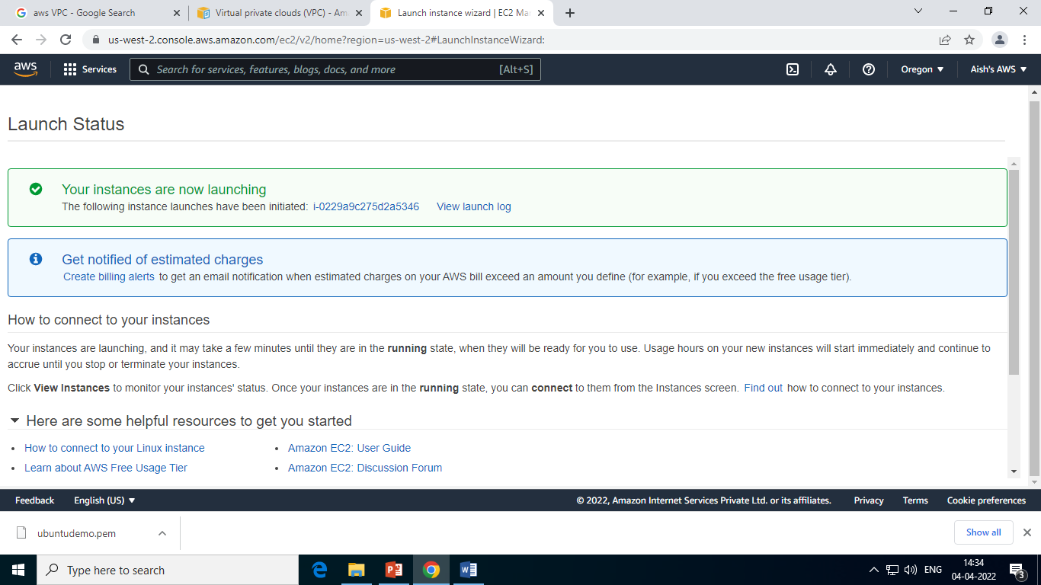
Create EC2 Instance

Slide 32
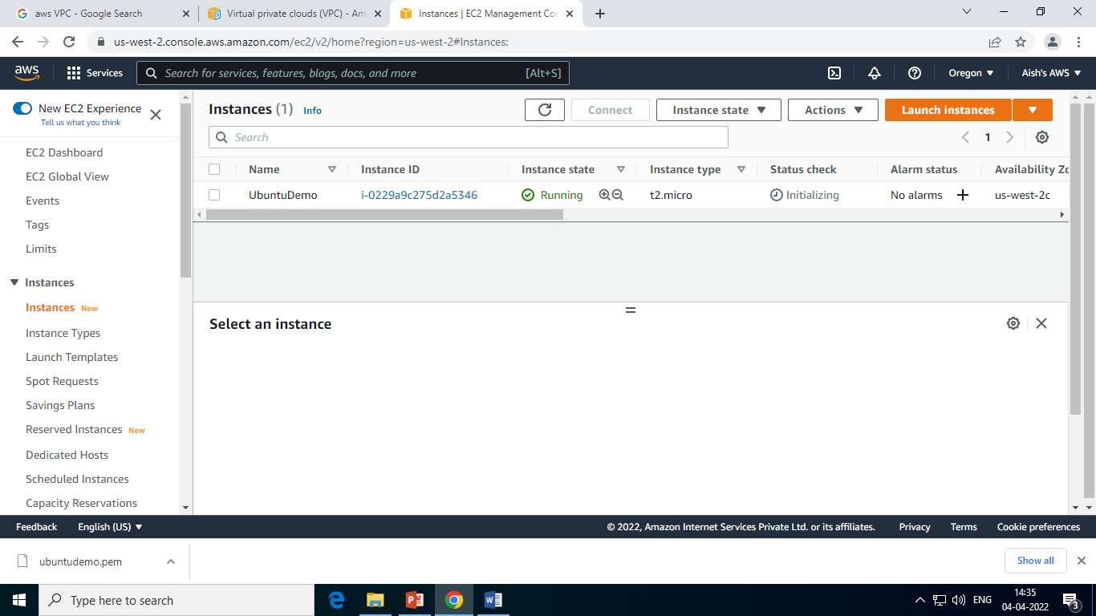
Create EC2 Instance

Slide 33
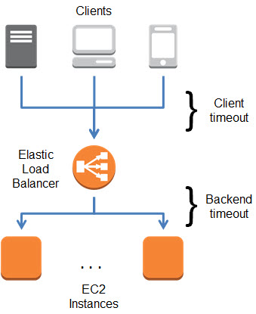
AWS Elastic Load Balancer
Elastic Load Balancer or ELB is a service provided AWS to distribute incoming traffic across multiple servers or clusters.
The ELB increase the availability and fault tolerance of an application.
It automatically distributes incoming application traffic across multiple Amazon EC2 instances.
ELB Work

Slide 34
Benefits of ELB
It is highly available and distributes website traffic across multiple targets.
It provides high security.
It can handle drastic change in website traffic.
It improve the visibility of your applications.
It supports hybrid load balancing.

Slide 35
Load balancer types
Elastic Load Balancing supports the following types of load balancers:
Application Load Balancers,
Network Load Balancers, and
Classic Load Balancers
Amazon ECS services can use these types of load balancer. Application Load Balancers are used to route HTTP/HTTPS (or Layer 7) traffic. Network Load Balancers and Classic Load Balancers are used to route TCP (or Layer 4) traffic.

Slide 36
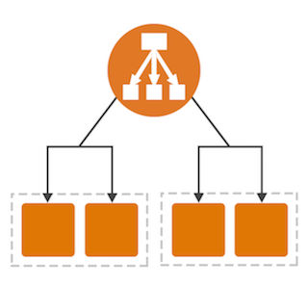
Application Load Balancer
An Application Load Balancer makes routing decisions at the application layer (HTTP/HTTPS).
Application Load Balancers support dynamic host port mapping.
When the task is launched, the NGINX container is registered
with the Application Load Balancer as an instance ID and
port combination, and traffic is distributed to the instance ID and
port corresponding to that container.

Slide 37

Network Load Balancer
A Network Load Balancer makes routing decisions at the transport layer (TCP/SSL). It can handle millions of requests per second.
It is mainly used for load balancing TCP traffic.

Slide 38
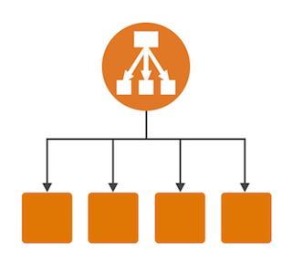
Classic Load Balancer
It is the load balancer that is used initially.
The classic load balancer in AWS is used on EC2-classic instances.
A Classic Load Balancer makes routing decisions at either the transport layer (TCP/SSL) or the application layer (HTTP/HTTPS).

Slide 39
Gateway Load Balancers
Gateway Load Balancers allow you to deploy, scale, and manage virtual appliances, such as firewalls, intrusion detection and prevention systems, and deep packet inspection systems.
It combines a transparent network gateway (that is, a single entry and exit point for all traffic) and distributes traffic while scaling your virtual appliances with the demand.
A Gateway Load Balancer operates at the third layer of the Open Systems Interconnection (OSI) model, the network layer.

Slide 40

AWS Virtual Private Cloud (VPC)
Amazon Virtual Private Cloud (Amazon VPC) enables you to
launch AWS resources into a virtual network that
you've defined.
This virtual network closely resembles a traditional
network that you'd operate in your own data center, with the benefits of using the
scalable infrastructure of AWS.
Benifits

Slide 41
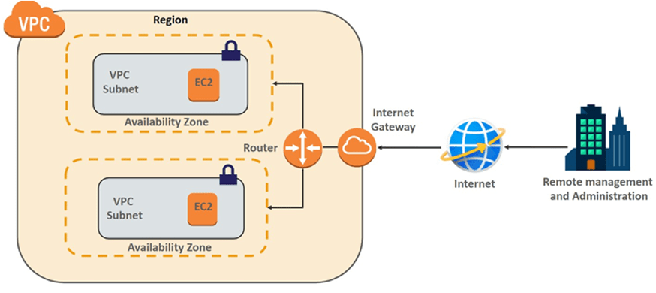
Components of VPC

Slide 42
Components of VPC
Route Table
Subnet
Security Groups
NAT Gateway
VPC Peering
Network access control list
Virtual private gateway
Customer gateway
Elastic IP
Network Interface
VPC Endpoints

Slide 43
AWS Storage
Cloud storage is a web service where your data can be stored, accessed and quickly backed up
by users on the internet.
It is more reliable, scalable and secure than traditional on premises storage system.
Cloud storage is offered in two models:
Pay only for what you use
Pay on monthly basis

Slide 44
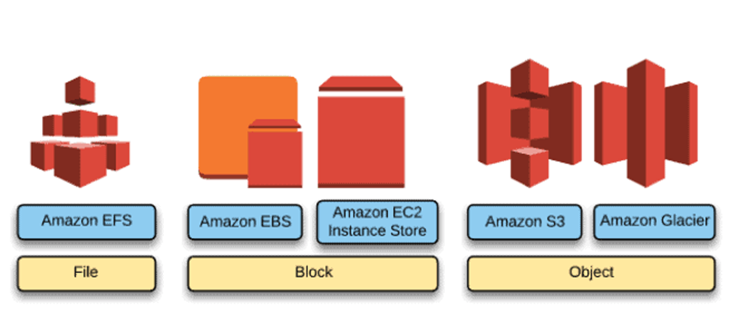
Storage offered by AWS

Slide 45
Amazon S3 Bucket
Amazon Simple Storage Service (Amazon S3) is an object storage service that offers industry-leading scalability, data availability, security, and performance.
Customers of all sizes and industries can use Amazon S3 to store and protect any amount of data for a range of use cases, such as data lakes, websites, mobile applications, backup and restore, archive, enterprise applications, IoT devices, and big data analytics.
Amazon S3 provides management features so that you can optimize, organize, and configure access to your data to meet your specific business, organizational, and compliance requirements.

Slide 46
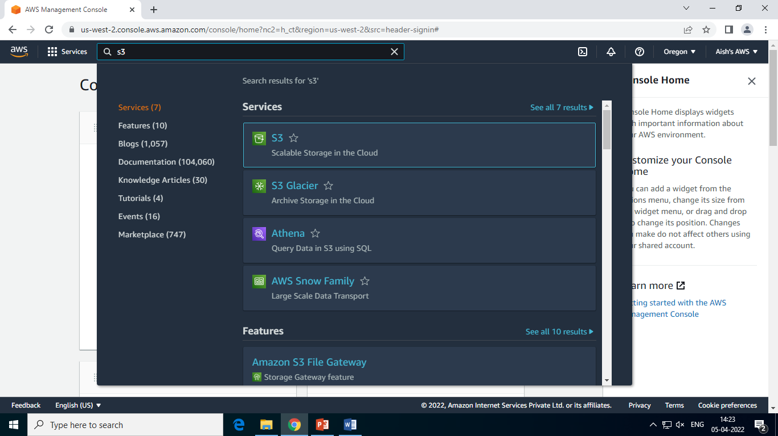
Creating Amazon S3 Bucket

Slide 47
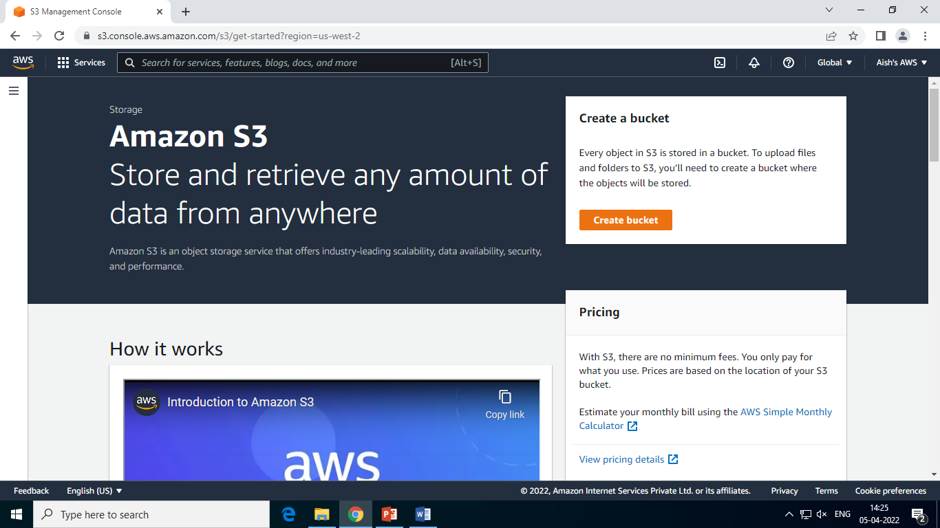
Creating Amazon S3 Bucket

Slide 48
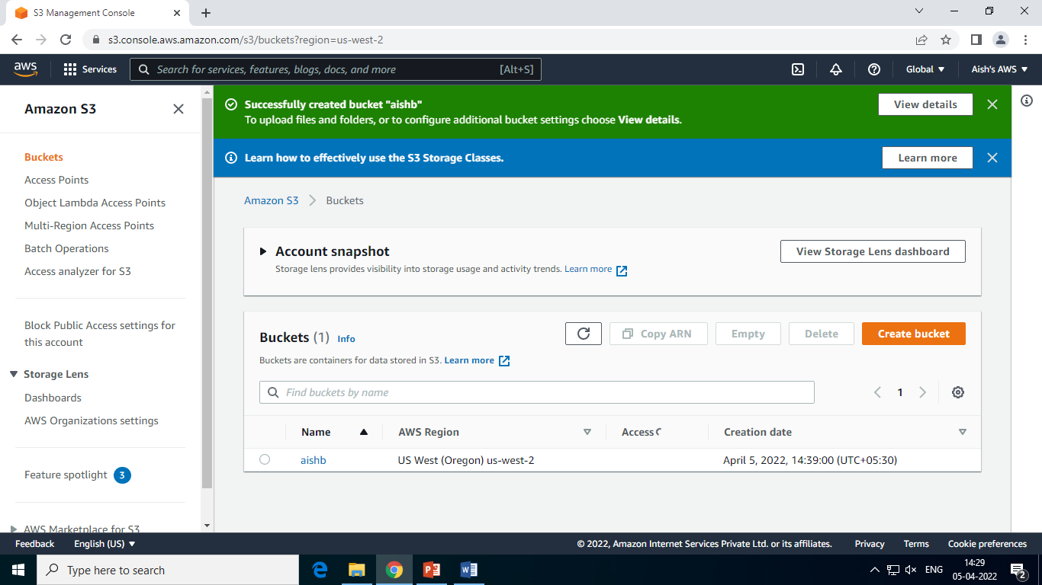
Creating Amazon S3 Bucket

Slide 49
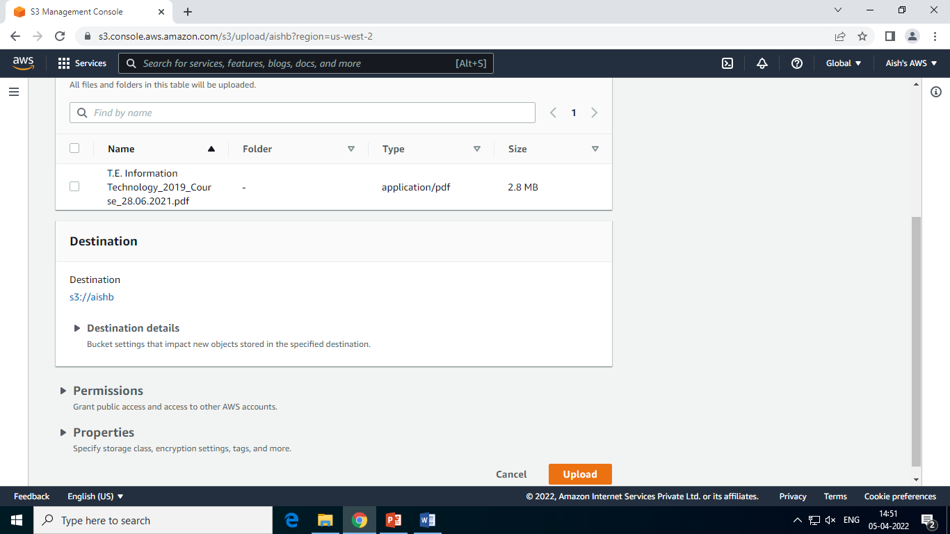
Creating Amazon S3 Bucket

Slide 50
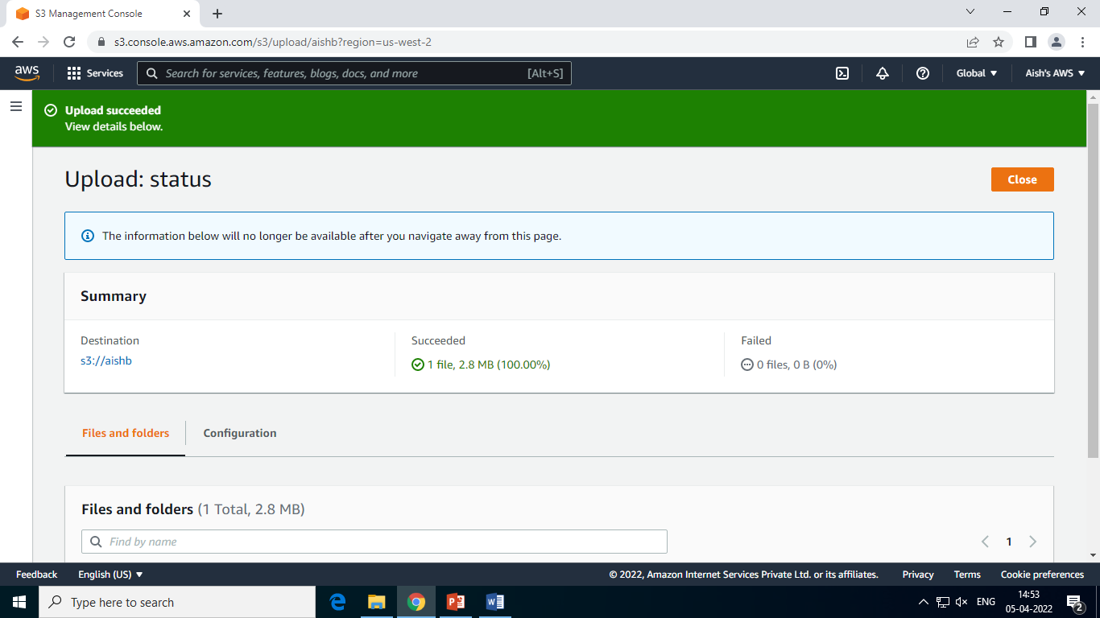
Creating Amazon S3 Bucket

Slide 51
Deploy Website or Web Application on AWS

Slide 52
AWS Elastic Beanstalk
AWS Elastic Beanstalk is an easy-to-use service for deploying and scaling web applications and services.
You can simply upload your code and Elastic Beanstalk automatically handles the deployment, from capacity provisioning, load balancing, auto-scaling to application health monitoring. At the same time, you retain full control over the AWS resources powering your application and can access the underlying resources at any time.
There is no additional charge for Elastic Beanstalk - you pay only for the AWS resources needed to store and run your applications.

Slide 53

Benefits AWS Elastic Beanstalk
Fast and simple to begin
Impossible to outgrow
Developer productivity
Complete resource control

Slide 54
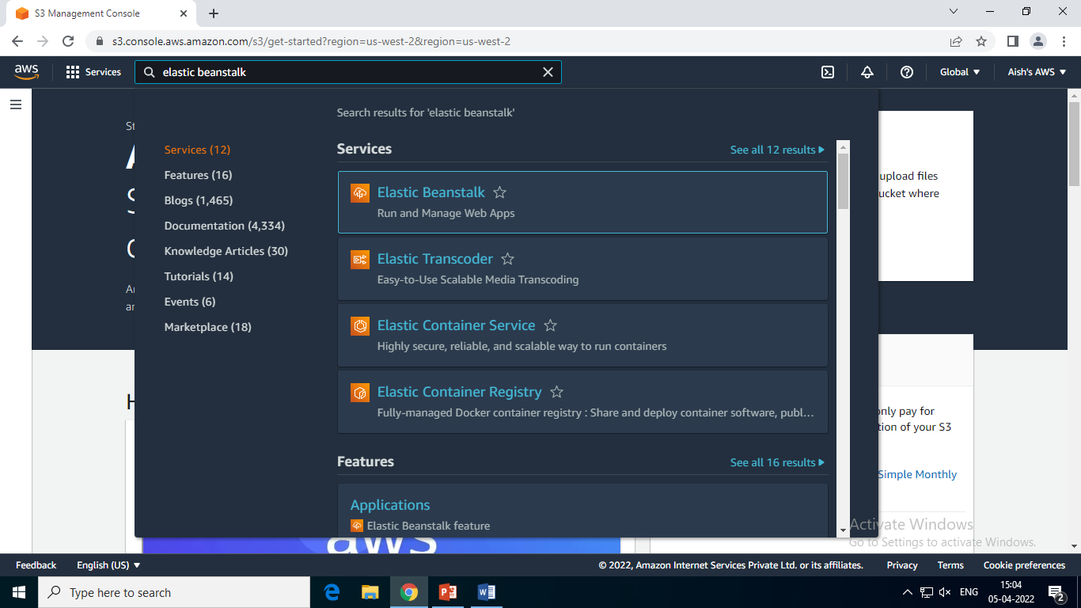
Launch an Application AWS Elastic Beanstalk

Slide 55
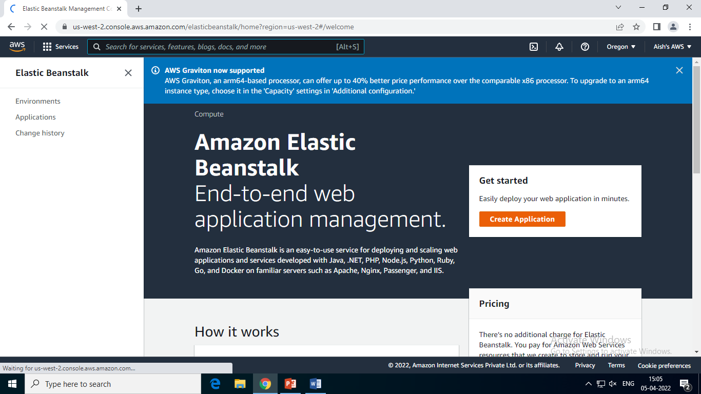
Launch an Application AWS Elastic Beanstalk

Slide 56
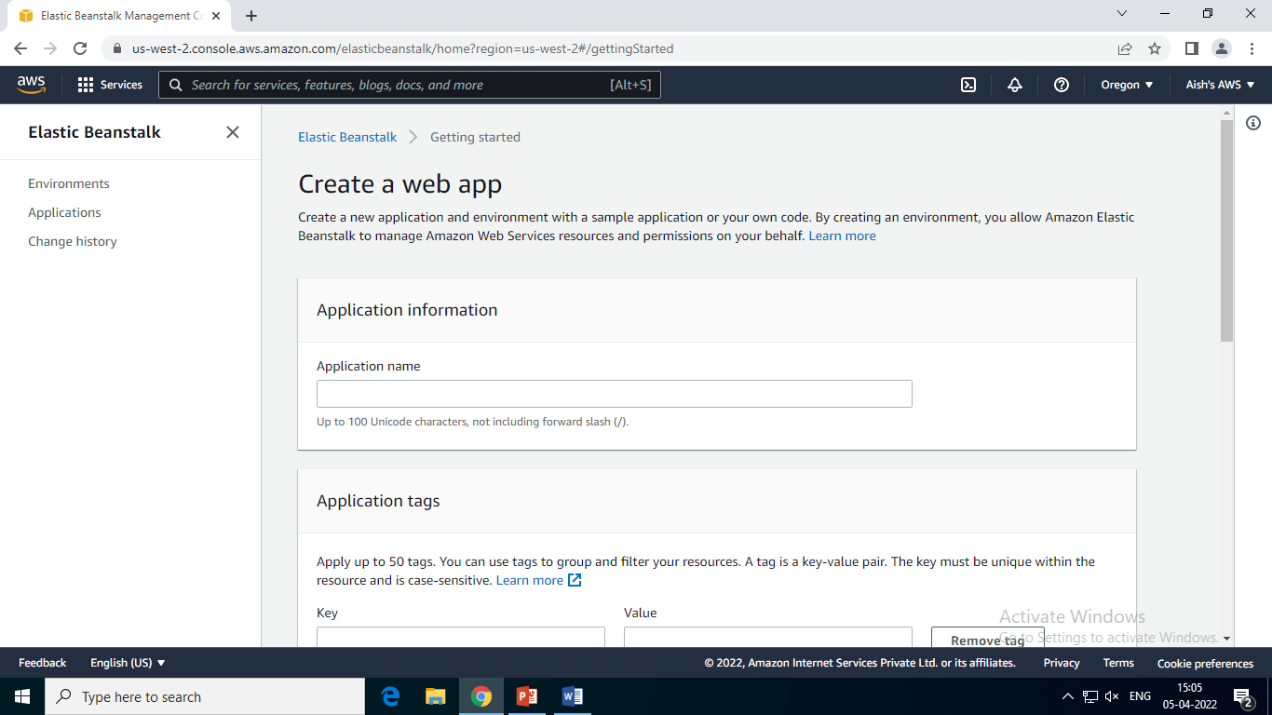
Launch an Application AWS Elastic Beanstalk

Slide 57
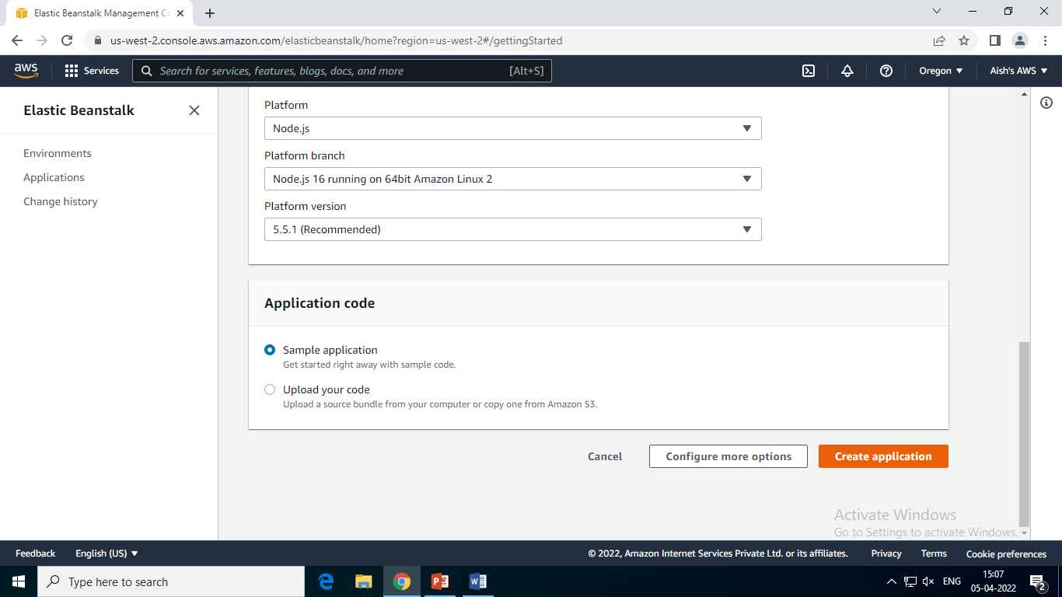
Launch an Application AWS Elastic Beanstalk

Slide 58
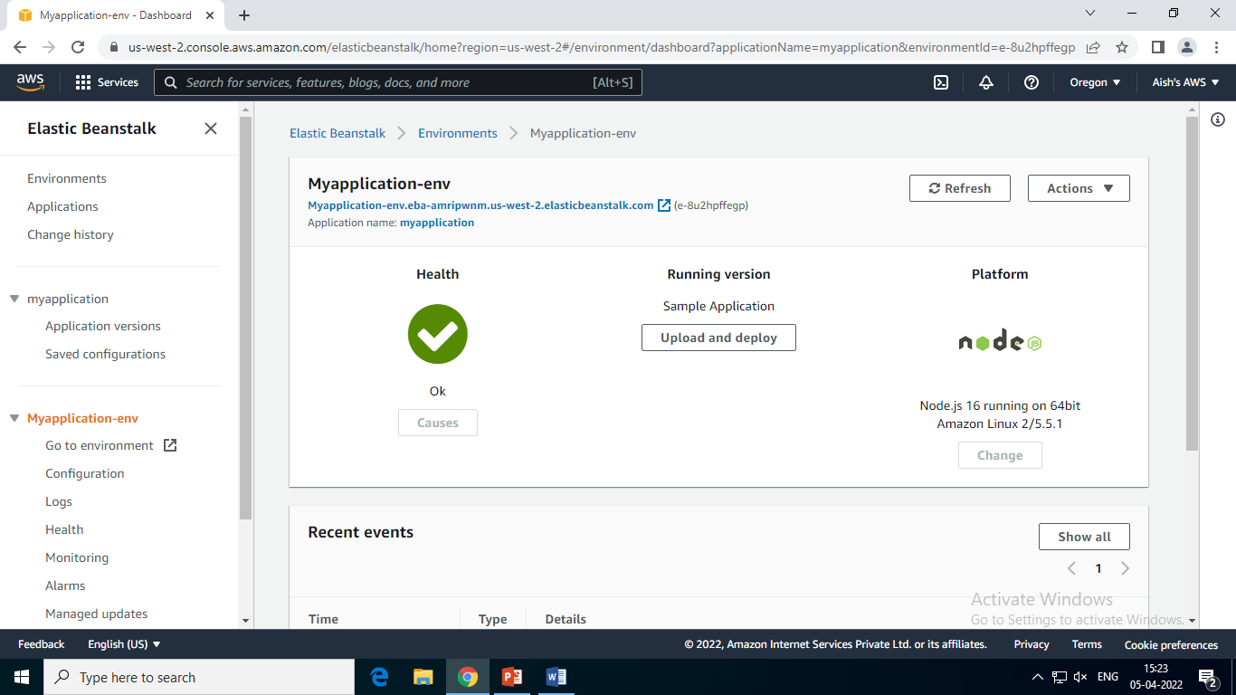
Launch an Application AWS Elastic Beanstalk

Slide 59
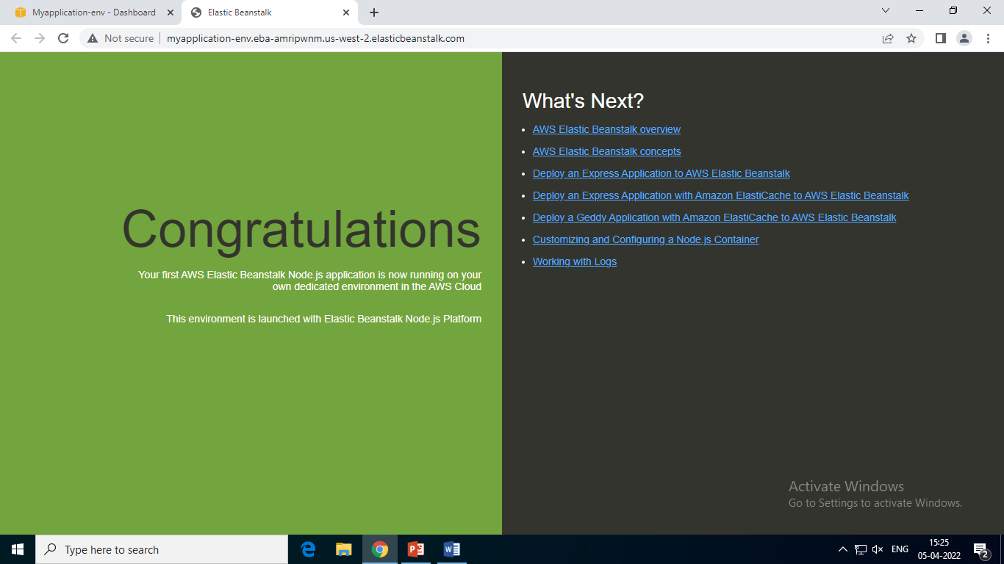
Launch an Application AWS Elastic Beanstalk

Slide 60
Thank You!!!

